Slide 1
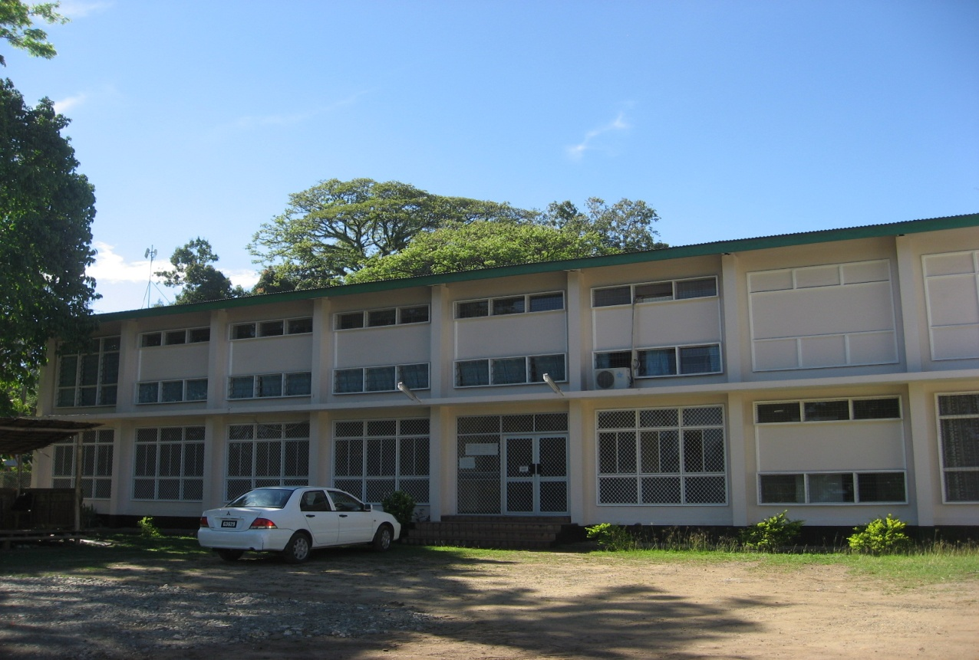
Volunteering at National Archives Solomon Islands

Slide 2
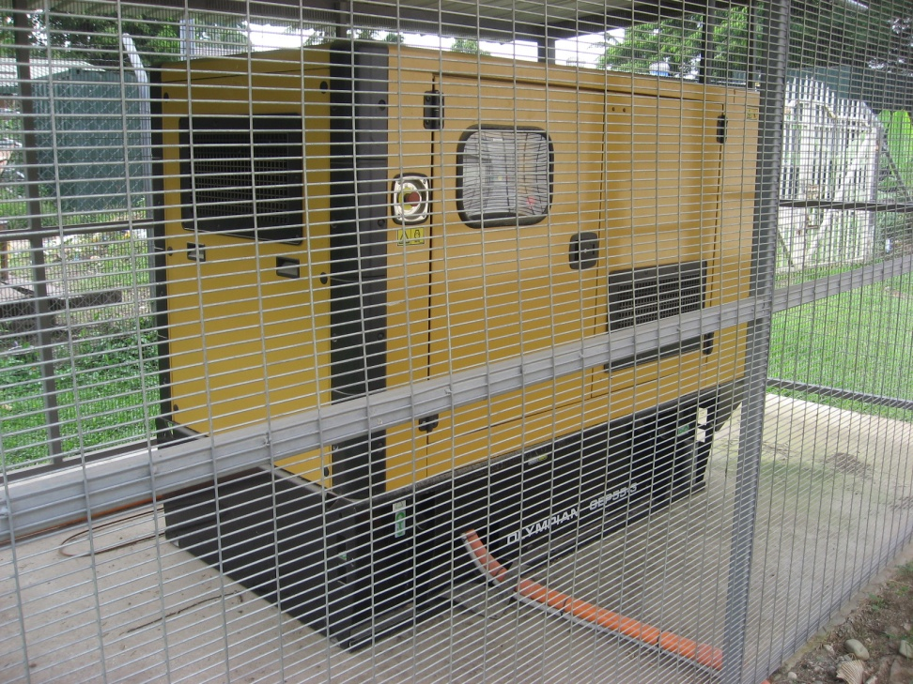
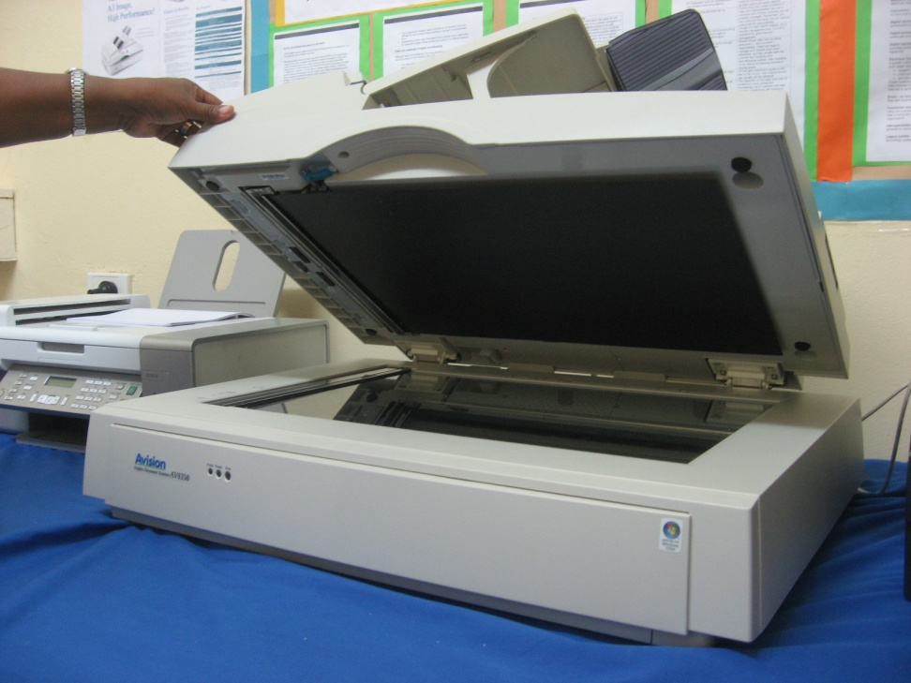
Building on SOLMAS
Standby Generator
Scanner & Internet cabling

Slide 3
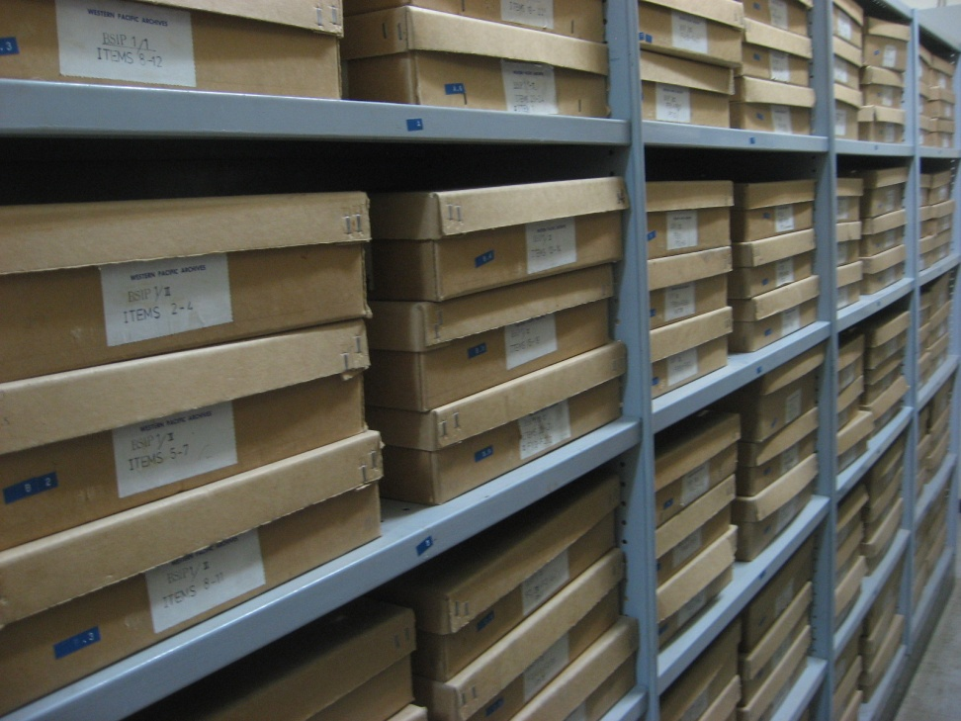
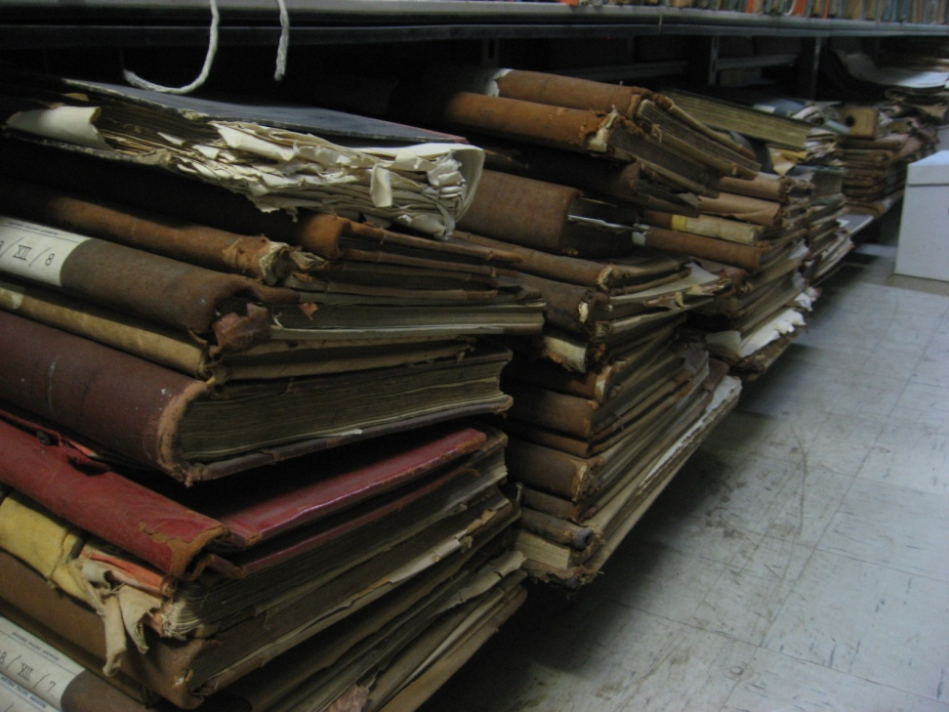
British Solomon Islands Protectorate Collection
870 boxes of records
60 bound volumes

Slide 4
My Assignment: Digitisation
Using the PARBICA ‘Recordkeeping for Good Governance Toolkit’, write NASI digitisation strategy, addressing at risk items and longer-term strategies.
Provide advice and training as appropriate. Oversee staff in the digitisation of high priority, at risk items.

Slide 5
Digital Readiness
NASI does not have:
Computer network
Shared drive
A server with backed up data or any other form of data backup
Consistent use of anti-virus software
Official email system or any official or in-house systems
An IT Helpdesk
Strict rules about procurement sources
Not all staff have computers or Internet access

Slide 6
Digital Readiness
I used the PARBICA Toolkit Digital Readiness Self-Assessment Tool. NASI scored in the ‘Low Readiness’ category.
NASI does not have:
Any electronic records management strategy
Any electronic records management policies
Any records back-up strategy

Slide 7
SIG-Connect network will:
Establish a LAN
Provide a server with off-site data back up
Supply secure, wireless internet
Take management of virus protection, including a content filter to stop the downloading of non-work related material
Provide professional-looking government email addresses
Provide IT Helpdesk support
Take on all future internet costs – a massive saving to the Ministry of Culture & Tourism
Provide a range of other ICT support facilities

Slide 8
Development Budget
February 2014, Solomon Islands National Museum and National Archives Solomon Islands receive funding from Solomon Islands Government to “reinvigorate” the two institutions.
Some of this funding is specifically for digitisation
Funding for 2014 is for consultancy and new equipment.
Further funding is likely for the next few years.

Slide 9
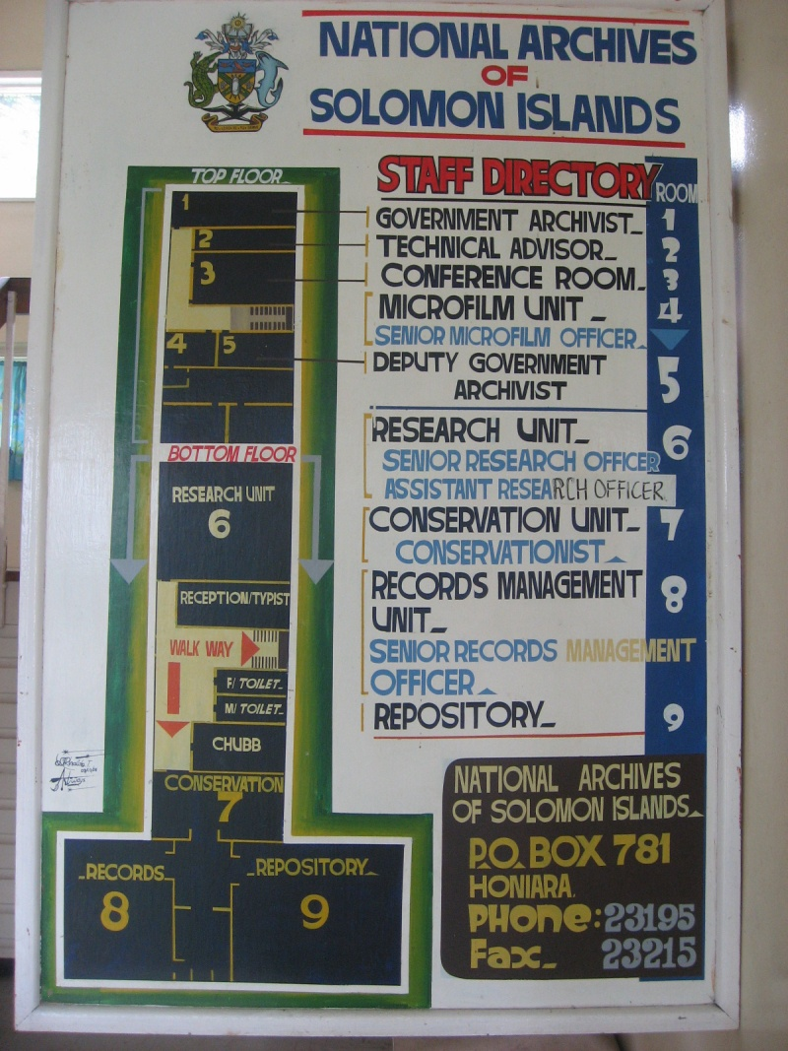
Challenges
Technology
Office not open plan
Cultural outsider
Different approaches to time and work
Working out of my area of comfort and speciality

Slide 10
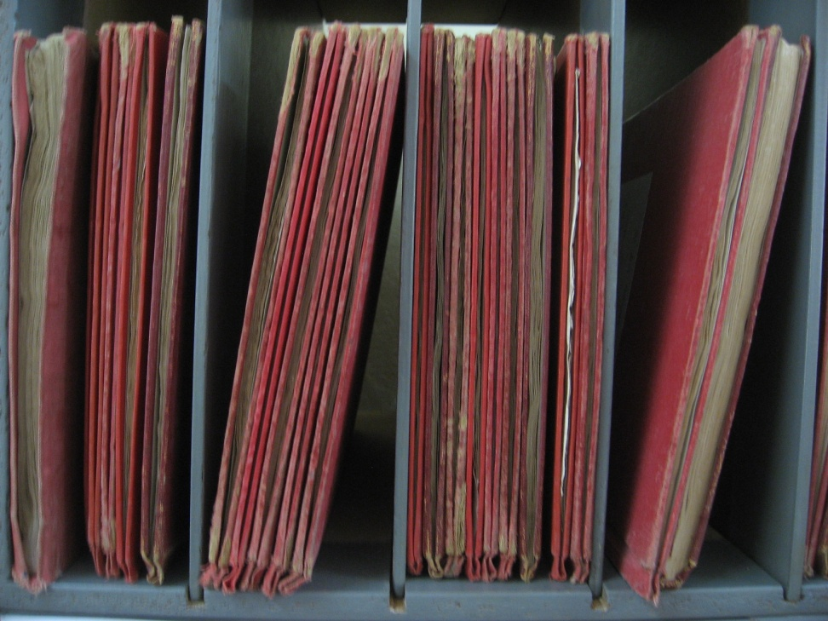
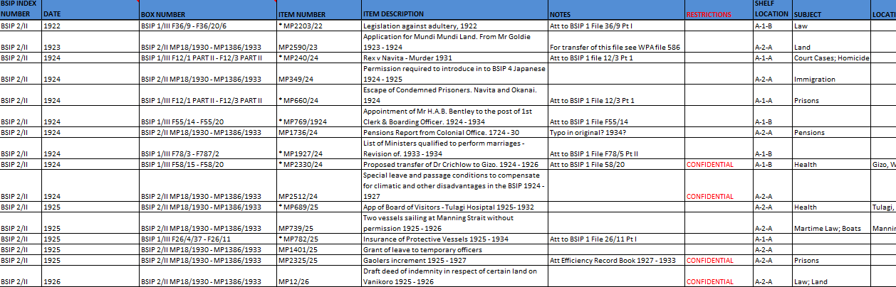
Achievements: BSIP Finding Aid
From this
To this

Slide 11
Achievements
It’s too soon to assess my achievements as all projects are still in progress
Putting SIG-Connect on the agenda
It’s small wins – staff enthusiasm for BSIP finding aid
One staff member taking delight in exceeding his own expectations of himself

